Slide 1






Hello Array Methods
PRESENTED BY:
Darie “007” Dorlus
Chief Happiness Officer
darie@bocacode.com

Slide 2
Pop Quiz?
What’s an ARRAY?

Slide 3
Nope, you are wrong!

Slide 4
An Array
Is a collection of items stored at contiguous memory locations, hopefully of the same type

Slide 5
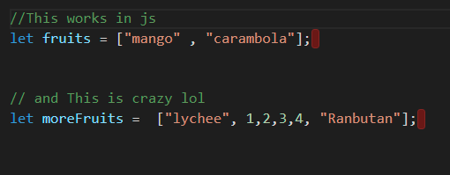
An Array

Slide 6
Common Array Methods

Slide 7
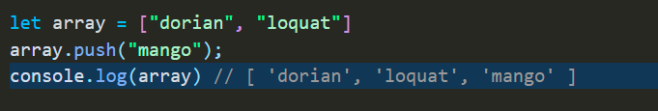
.push(“mango”)
append mango to the end of the array

Slide 8
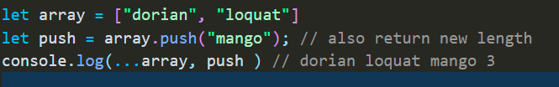
.push(“mango”)
also returns the new length

Slide 9
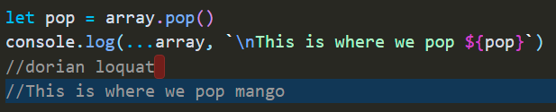
.pop()
removes and returns the last element

Slide 10
.shift()
removes and returns the first element

Slide 11
.unshift(“kiwi”)
add element at the beginning of the array

Slide 12
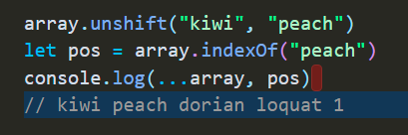
.indexOf(“peach”)
Returns the index of the 1st occurrence of the element or -1 if not found

Slide 13
.splice(pos, 1)
Removes 1 element from array starting from pos.
Also returns a new array of the deleted elements

Slide 14
.splice()
Makes shallow copy of the entire array

Slide 15
.concat(arr1, arr2, …)
Combines 2 or more arrays
Returns a completely new array

Slide 16
.foreach(function(val, i, arr){ })
Combines 2 or more arrays
Returns a completely new array

Slide 17
Part 2

Slide 18
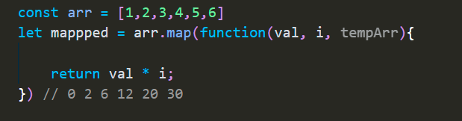
.map(function(val, i, arrr){})
Returns new array with results of function

Slide 19
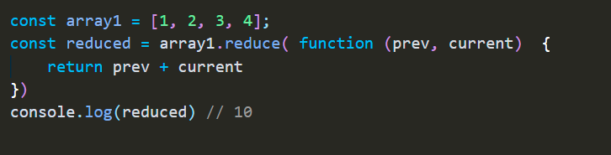
.reduce( function(prev, current ){} )
Apply the callback function on every element returning a single value

Slide 20
.sort(function(first, second){ })
Sorts an array in place
Sorts in ascending or by default

Slide 21
Thank You.

